Slide 1
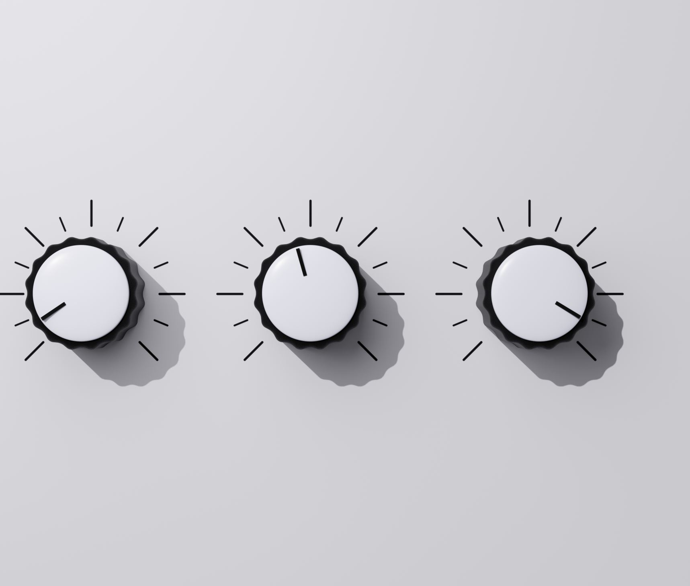
W3C Validator
Validating your HTML code

Slide 2
What is the W3C Markup Validation Service
The W3C Markup Validation Service is like a super helpful checker for websites.
It's a bit like proofreading an essay. When you write an essay, you want to make sure it's clear and follows all the grammar rules so others can understand it easily.
The W3C validator does the same thing but for your website's code.
Using this service is super important because it helps make sure your website behaves properly. It catches mistakes or problems in your code that might cause issues like broken features, strange-looking layouts, or things not working as they should in different web browsers.
By checking your website's code with the W3C Markup Validation Service, you can fix those mistakes early on and make sure your site works well for everyone who visits, no matter what browser they're using.

Slide 3
Get your HTML File Ready
Make sure your HTML code is saved in a file with a 'html' extension.
You might consider doing this:
Go to templates and your html code for base, weather_forecast and forecast_result.
Open Notepad ++ and copy your code in there
When saving your code select Hyper Text Markup Language file in 'Save as type'

Slide 4
Access the W3C Markup Validation Service
Go to W3C Markup Validation Service
Click on the "Validate by File Upload" option if your HTML file is on your local machine.

Slide 5
Upload your HTML file
Click the "Choose File" button.
Navigate to your HTML file in the file explorer and select it.
Click on the "Check" button.

Slide 6
Review the validation rules
The validator will analyse your HTML file and display the validation results.
It will show errors, warnings, or information about your HTML code.
Errors: These are critical issues that need to be fixed as they indicate problems that can affect how your website is displayed or functions.
Warnings: These are issues that don't necessarily break your code but could cause unexpected behavior or future problems.
Information: These are notices about your code that might be helpful but don't necessarily indicate problems.

Slide 7
Address the issues
Review the errors and warnings provided by the validator.
Go back to your code in Visual Studio Code and make necessary changes to fix the issues.
Save the file after making changes.

Slide 8
Re-validate
Repeat the process by re-uploading the updated HTML file to the W3C Markup Validation Service to ensure you've addressed all the issues.
Remember, fixing validation errors doesn't guarantee that your website will look the same on all browsers, but it helps ensure your HTML is correctly structured according to standards, which can reduce compatibility issues.

